Slide 1

Real-Time Programming Lecture 10- SPINLOCK, MONITORS
CCNE Department
Lebanese University
Rola El Osta

Slide 2
What is Spinlock?
A spinlock is a lock where the thread simply waits in a loop ("spins") repeatedly checking until the lock becomes available. Since the thread remains active but isn't performing a useful task, the use of such a lock is a kind of busy waiting. Spinlocks are efficient if threads are only likely to be blocked for a short period of time, as they avoid overhead from operating system process re-scheduling or context switching. For this reason, spinlocks are often used inside operating system kernels. However, spinlocks become wasteful if held for longer durations, preventing other threads from running and requiring re-scheduling.

Slide 3
Using Spin Locks
Spin locks are a low-level synchronization mechanism suitable primarily for use on shared memory multiprocessors. When the calling thread requests a spin lock that is already held by another thread, the second thread spins in a loop to test if the lock has become available. When the lock is obtained, it should be held only for a short time, as the spinning wastes processor cycles. Callers should unlock spin locks before calling sleep operations to enable other threads to obtain the lock.

Slide 4
Spin locks can be implemented using mutexes and conditional
variables, but the pthread_spin_* functions are a standardized way
to practice spin locking.
The pthread_spin_* functions require much lower overhead for locks
of short duration.

Slide 5
When performing any lock, a trade-off is made between the processor resources consumed while setting up to block the thread and the processor resources consumed by the thread while it is blocked. Spin locks require few resources to set up the blocking of a thread and then do a simple loop, repeating the atomic locking operation until the lock is available. The thread continues to consume processor resources while it is waiting.
Compared to spin locks, mutexes consume a larger amount of processor resources to block the thread. When a mutex lock is not available, the thread changes its scheduling state and adds itself to the queue of waiting threads. When the lock becomes available, these steps must be reversed before the thread obtains the lock. While the thread is blocked, it consumes no processor resources.
Therefore, spin locks and mutexes can be useful for different purposes. Spin locks might have lower overall overhead for very short-term blocking, and mutexes might have lower overall overhead when a thread will be blocked for longer periods of time.

Slide 6
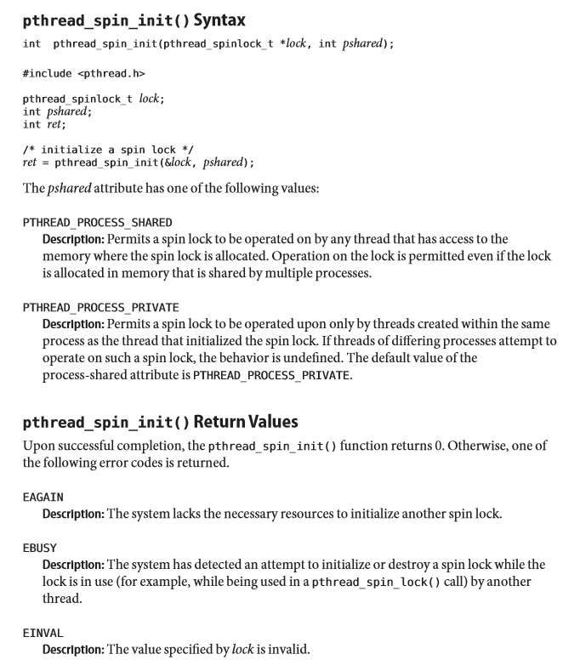
1. Initializing a Spin Lock Use the pthread_spin_init function to allocate resources required to use a spin lock, and initialize the lock to an unlocked state.

Slide 7
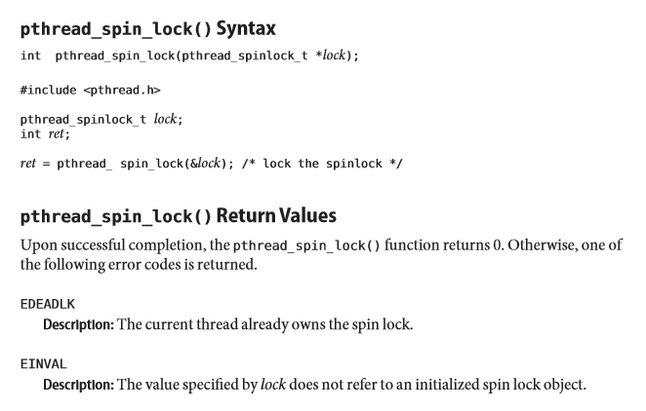
2. Acquiring a Spin Lock Use the pthread_spin_lock to lock a spinlock. The calling thread acquires the lock if it is not held by another thread. Otherwise, the thread does not return from the pthread_spin_lock() call until the lock becomes available. The results are undefined if the calling thread holds the locke at the time the call is made.

Slide 8
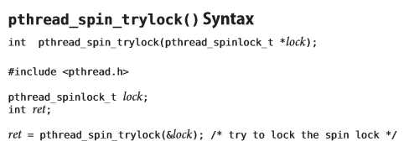
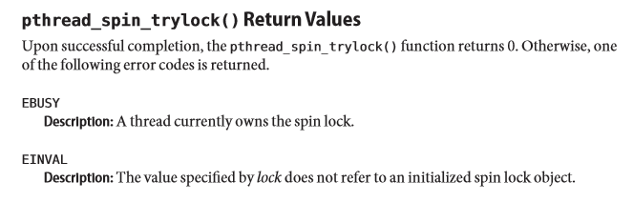
3. Acquiring a Non-Blocking Spin Lock Use the pthread_spin_trylock function to lock a spin lock and fail immediately if the lock is held by another thread.

Slide 9
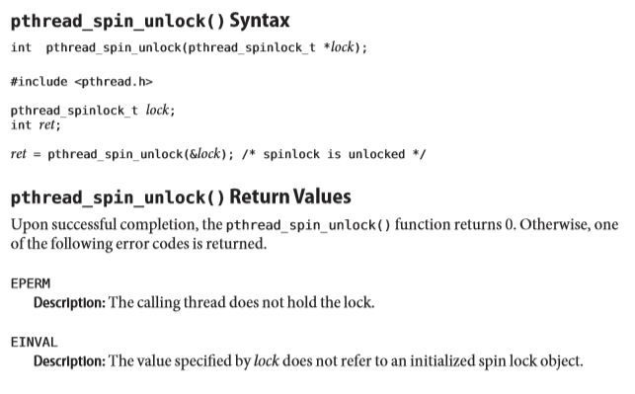
4. Unlocking a Spin Lock
Use the pthread_spin_unlock function to release a locked spin lock.

Slide 10

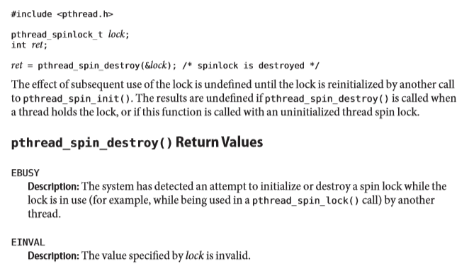
5. Destroying a Spin Lock Use the pthread_spin_destroy function to destroy a spin lock and release any resources used by the lock.

Slide 11
Using Spinlock: Example
In the following example we create two threads, thread1 and thread2. We initialize a spinlock "my_lock" and both the threads try to acquire the lock .
In the following example we create two threads, thread1 and thread2. We initialize a spinlock "my_lock" and both the threads try to acquire the lock . Thread1 is made to get to the lock first. After acquiring the lock thread1 waits for one minute before releasing the lock. During this time thread2 attempts to acquire the lock too. We have used the function spin_trylock, so if the thread2 is unable to hold the spinlock it will return immediately with a return value of non zero. Thus we will define a spinlock using
static spinlock_t my_lock=SPIN_LOCK_UNLOCKED

Slide 12
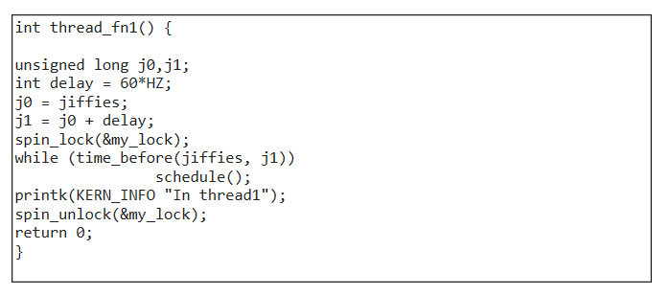
Starting with the spinlock in unlocked state. We will create the two threads thread_fn1 and thread_fn2 using the function kthread_create. The first thread function thread_fn1 will hold the lock and loop for approximately on minute the code for which is

Slide 13
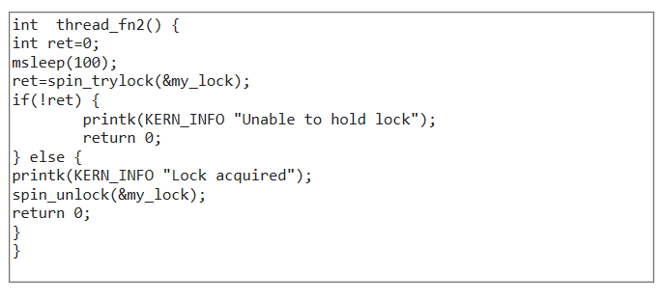
The second thread function thread_fn2 will try to hold try to hold the lock using spin_trylock.A sleep of 100ms is added at the beginning to make sure that the first thread gets to the lock first.Thus the code for the second thread function will be

Slide 14
If the thread_fn2 is able to get the lock we will see the message "Lock acquired" in the kernel log. If the thread_fn2 is unable to get the lock we will see the message "Unable to hold lock" in the kernel log. The complete code will be spinlock_example.c

Slide 15
Concept of Monitor
In concurrent programming, a monitor is a synchronization construct that allows threads to have both mutual exclusion and the ability to wait (block) for a certain condition to become true.
Monitors were invented by Per Brinch Hansen and C. A. R. Hoare in 1974 to resolve the problem of synchronisation, and were first implemented in Brinch Hansen's Concurrent Pascal language.
Type m = monitor
Start
Declaration of local variables;
Declaration and body of monitor’s procedures; // access to mutual exclusion Initialisation;
End
The procedures of monitor are synchronised with the two primitives :
Wait()
Signal()
that can block or wake up a process on a.
A condition is a variable that has no value but is implemented using a queue.
Syntaxe of primitives :
Cond.Wait() : always blocks the calling process
Cond.Signal() : wakes up a process blocked in the queue associated with Cond.

Slide 16
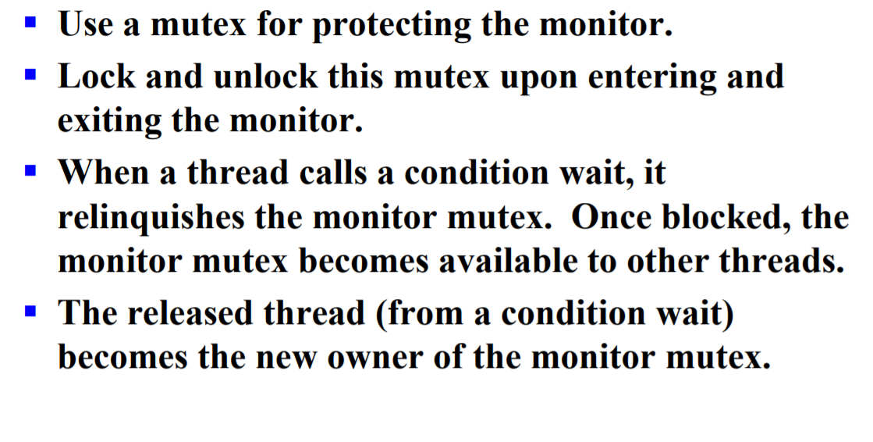

Slide 17
POSIX Monitors
A Posix monitor is the association
- of a mutex (type pthread_mutex_t) which serves to protect the part of code where we test the conditions.
- and of a condition variable (type pthread_cond_t) which serves as a point of signaling:
we wait on this variable by the primitive:
pthread_cond_wait (& CondVariable, & Mutex);
we are awake on this variable with the primitive:
Wake up a waiting thread that acquires the mutex again
pthread_cond_signal (& CondVariable);

Slide 18
Diagram of use
Let C is the condition,
The diagram of use for Posix monitors is as follows:
pthread_mutex_lock (&Mutex);
Evaluate C;
while ( ! C ) {
pthread_cond_wait(&CondVariabl,&Mutex);
Re-Evaluate C if necessary
}
Do the work;
pthread_mutex_unlock(&Mutex);

Slide 19
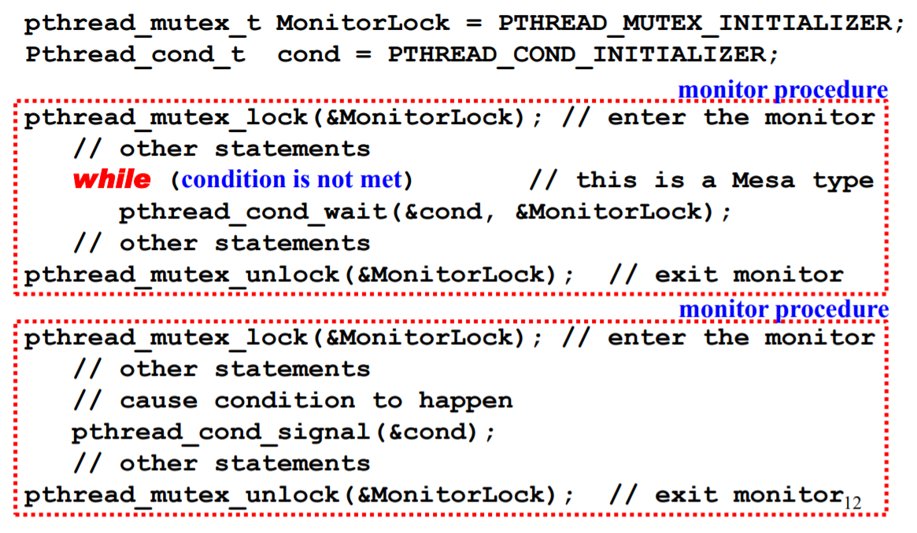

Slide 20
Example of POSIX Monitor with Cons/Producer Model
Go to Practicize!!!
Solution is: ConsProd_monitor.c

